Slide 1
1. ALL images - no background
2. ALL images – 1-time size as background
3. ALL images – 2-time size as background
4. ALL images – 3-time size as background
5. Only side view images- no background
6. Only side view images – 1-time size as background
7. Only side view images – 2-time size as background
8. Only side view images – 3-time size as background

Slide 2
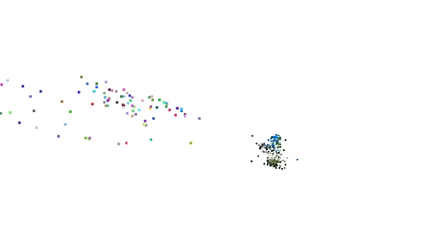
1. ALL images - no background

Slide 3
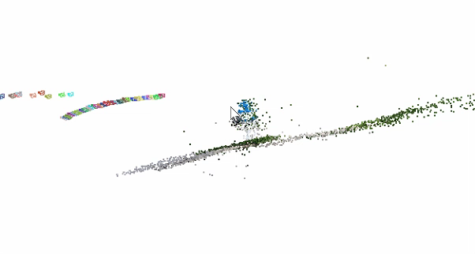
2. ALL images – 1-time size as background

Slide 4
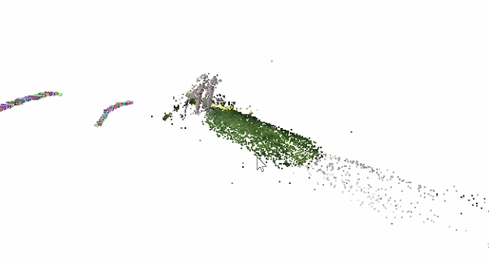
3. ALL images – 2-time size as background

Slide 5
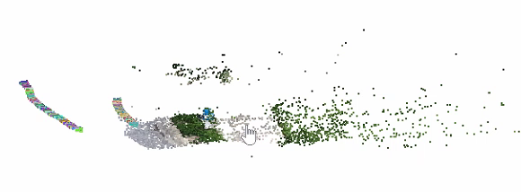
4. ALL images – 3-time size as background

Slide 6

5. Only side view images- no background

Slide 7

6. Only side view images – 1-time size as background

Slide 8
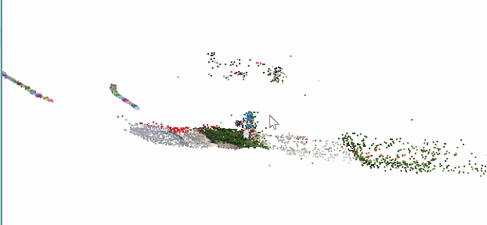
7. Only side view images – 2-time size as background

Slide 9
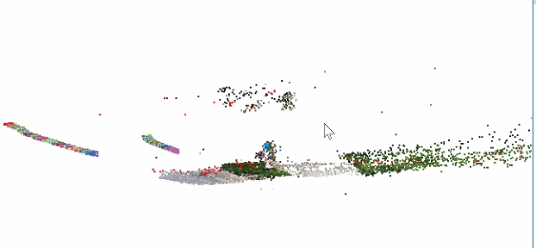
8. Only side view images – 3-time size as background

Slide 10
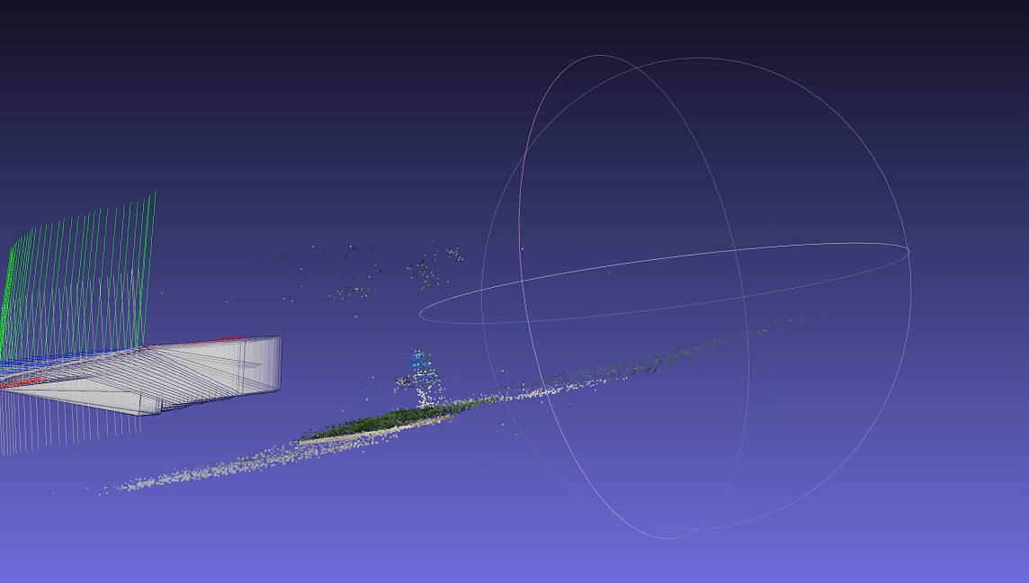
MeshLab

